Slide 1
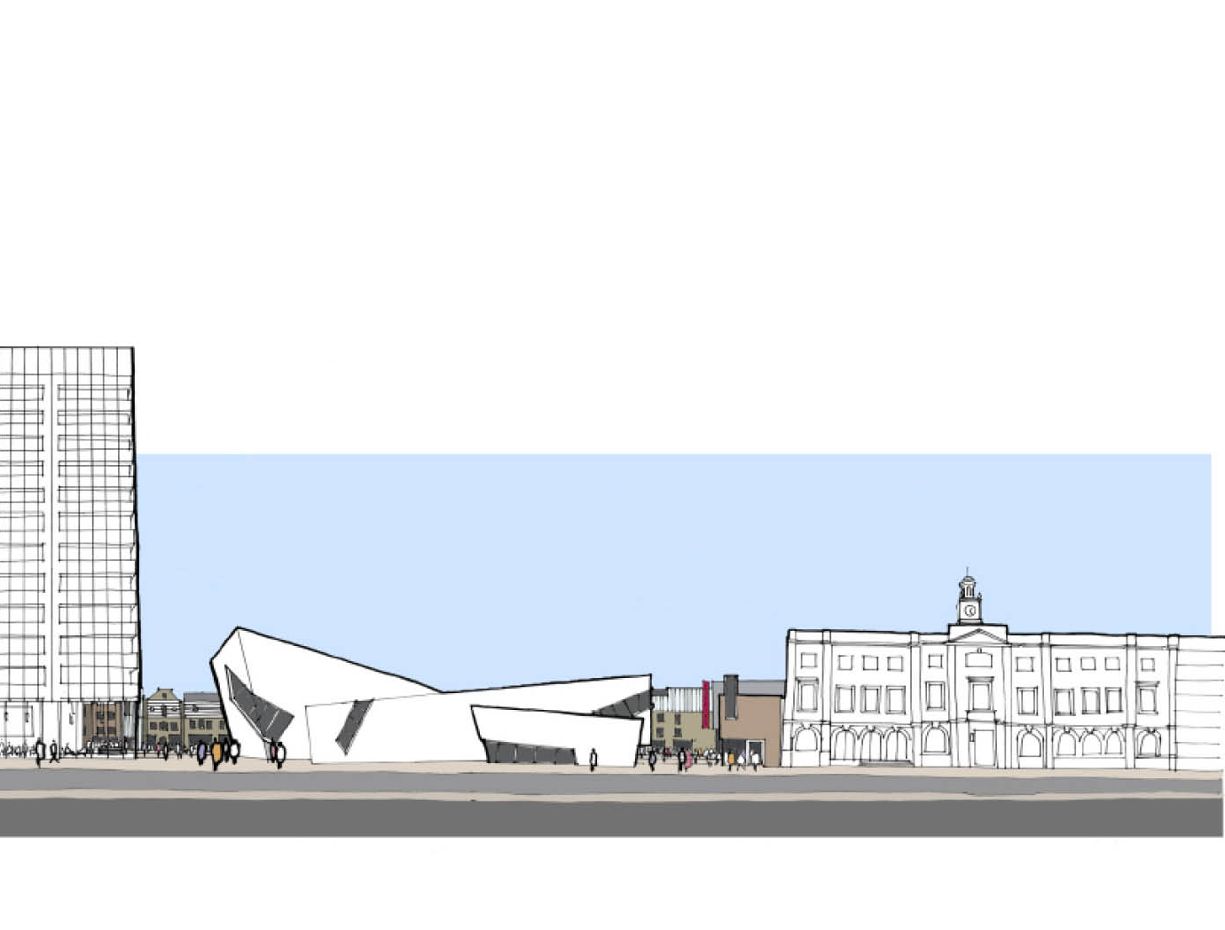

Start of Year meetings
8 September 2016
13 September 2016
15 September 2016

Slide 2
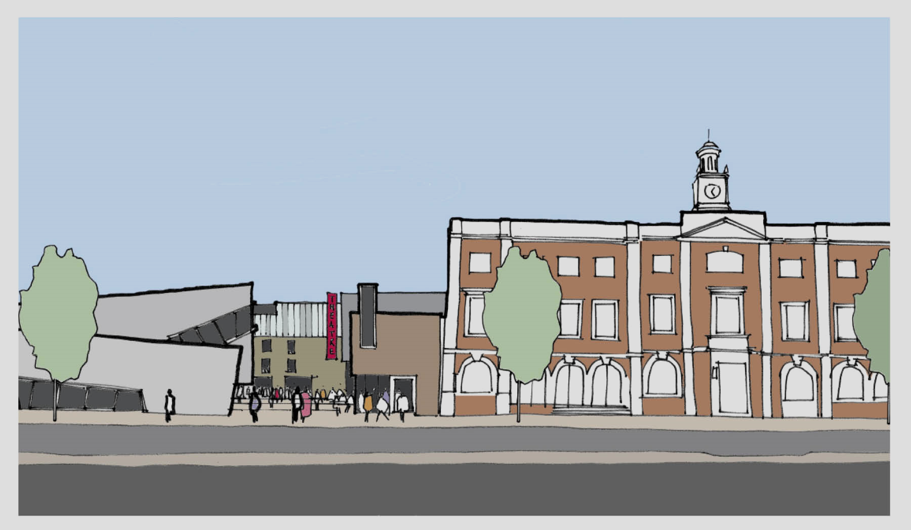

Lots done, lots to do
Achievements 2015-16
Priorities for year ahead
What matters in 2016-17?

Slide 3


1. Teach with quality and care
The teaching in my class
Assessment and feedback
Academic support

Slide 4
NSS 2016 UNIVERSITY BENCHMARK
84

Slide 5
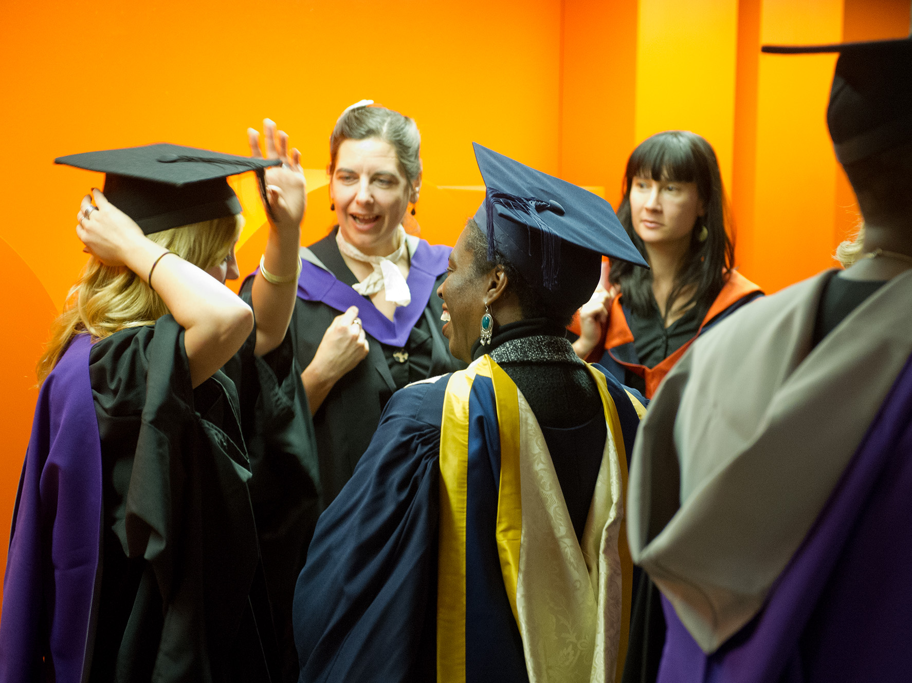


Start of Year meetings
[change for each] September, 2016
2. Improve student outcomes
Relentless focus on quality
Reduce drop outs, increase continuation rates, for all
Good completions
Graduate employment

Slide 6
DLHE 14-15 UNIVERSITY BENCHMARK
90.1

Slide 8

3. Increase enrolments
To existing portfolio
Through new products, such as degree apprenticeships

Slide 9
4. Grow our income through:
Increased enrolments to existing portfolio
New products, such as degree apprenticeships
Research and consultancy

Slide 10

5. Control our costs
For example: staff costs as a percentage of income
2014 - 67%
2016 - 60%
2017 - 54%

Slide 11
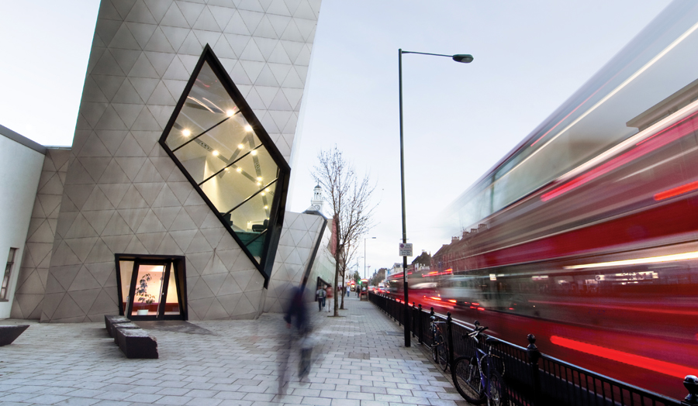
6. Repair London Met’s reputation by:
Improved outcomes for our students
No compliance errors
Contributing to the community, the city and the world through our scholarship

Slide 12
Six things which matter in 2016-17
1. Teach with quality and care
2. Improve student outcomes
3. Increase enrolments
4. Grow our income
5. Control our costs
6. Repair London Met’s reputation

